Slide 1
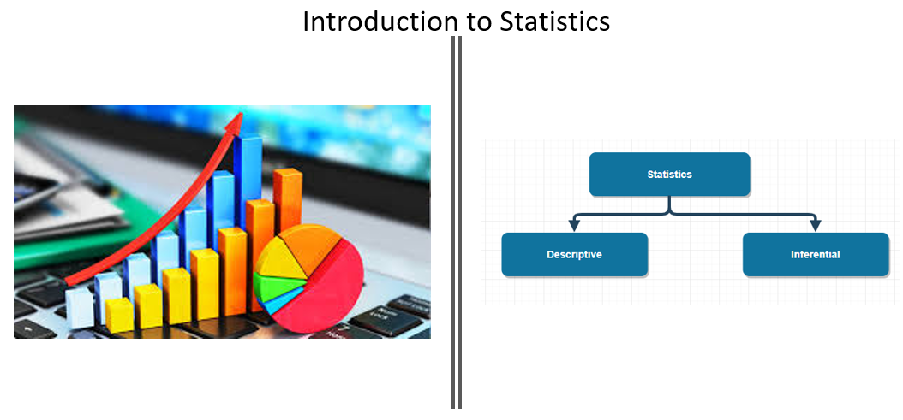

Slide 2
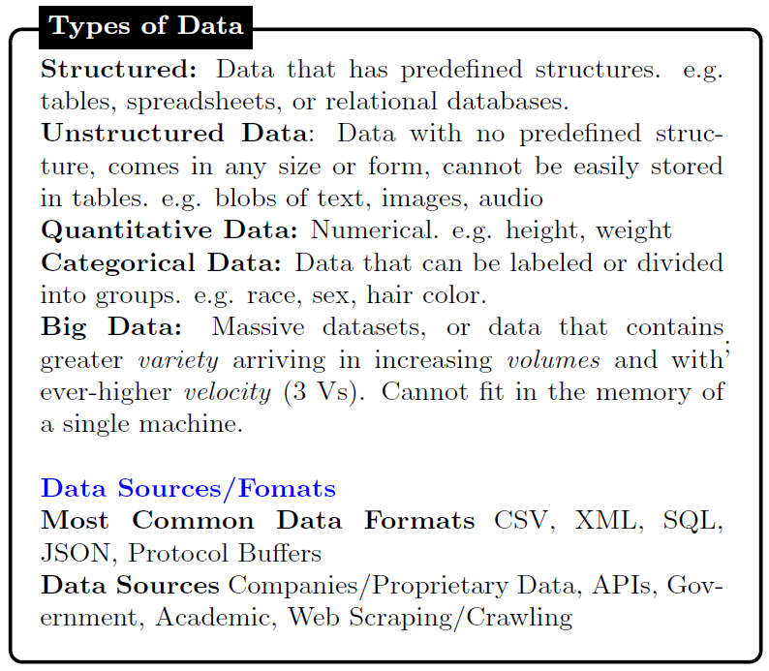

Slide 3
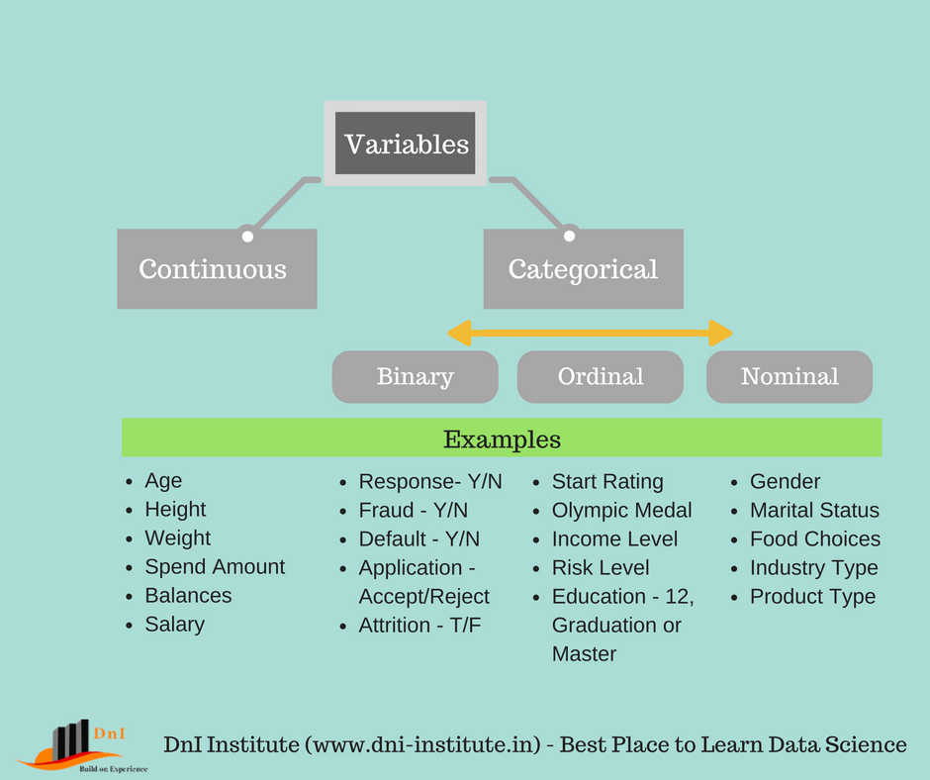

Slide 4
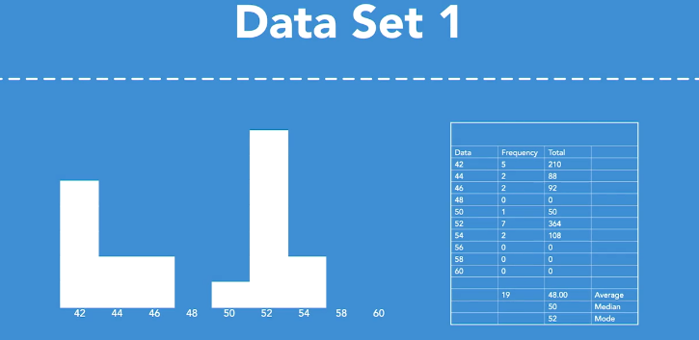

Slide 5
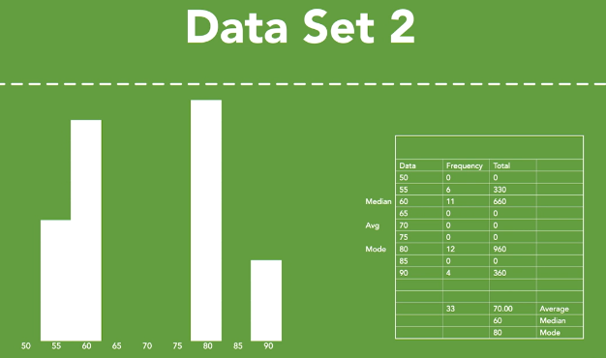
As you can see, mode, median, mean, none of these on their own provide us a complete picture, but when you use mode, median, mean in a chart together you get a nice glimpse of your complete data set, and perhaps now you can start to ask the deeper question about the data set and how it might help you make better decisions.

Slide 6
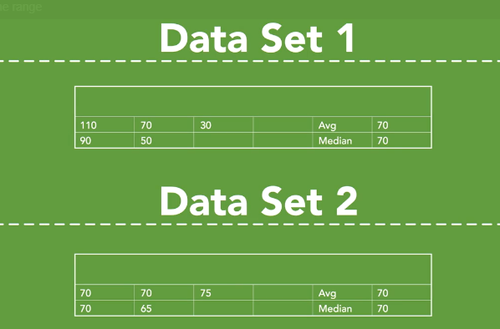
These data sets are small so we can quickly view all of the data and see the differences. What happens when the data sets are enormous? How can we measure the differences in data sets that might have very similar medians and means?

Slide 7
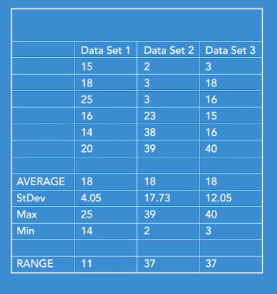

Slide 8
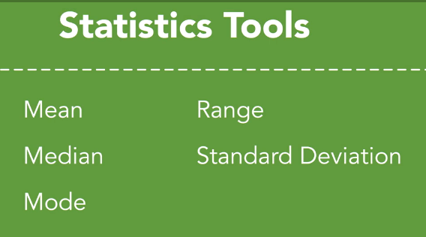

Slide 9
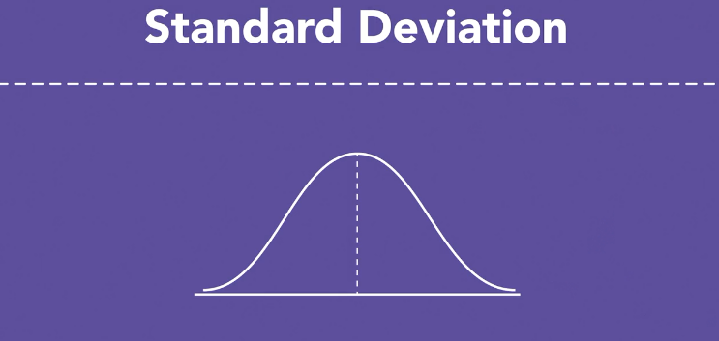
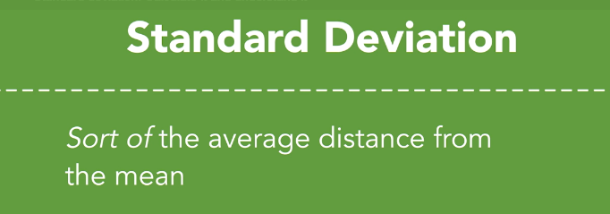

Slide 10
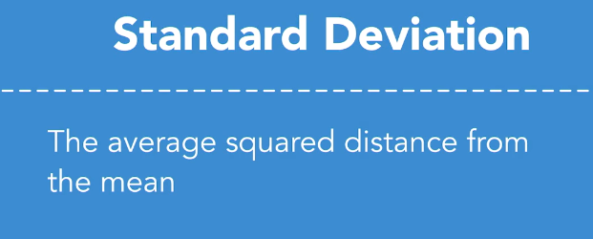
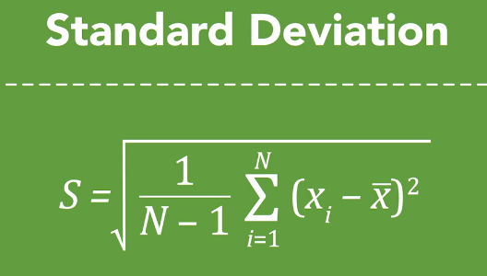
X=Data values
n= # of items in a sample
N=# of items in a Pop.
X(with bar)= Sample Mean
Meu=Population mean

Slide 11
Measure of Variability
The Variance is defined as:
The average of the squared differences from the Mean.
To calculate the variance follow these steps:
Work out the Mean (the simple average of the numbers)
Then for each number: subtract the Mean and square the result (the squared difference).
Then work out the average of those squared differences.

Slide 12
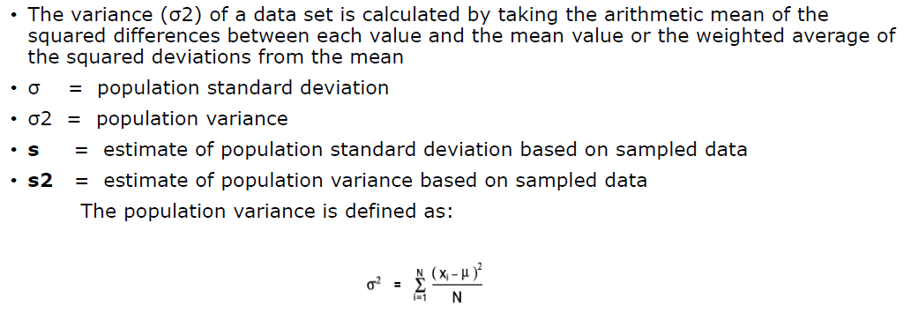
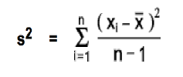
Standard Deviation & Variance (Measure of dispersion)
X=Data values
n= # of items in a sample
N=# of items in a Pop.
X(with bar)= Sample Mean
Meu=Population mean

Slide 13
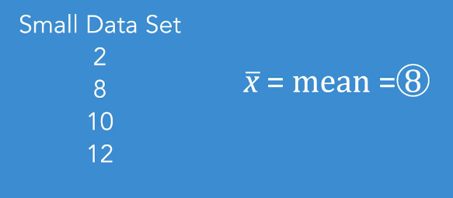
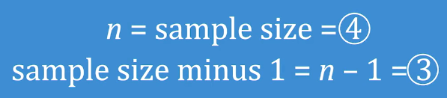
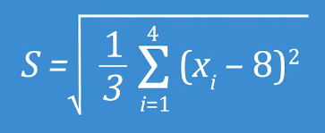
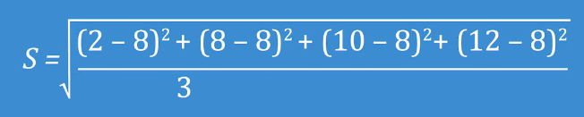
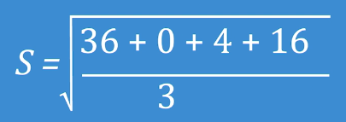
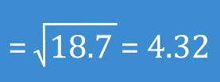

Slide 14
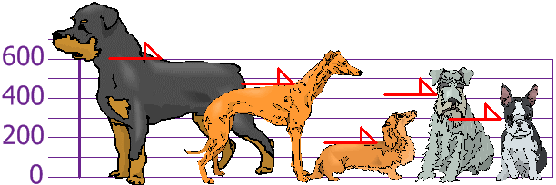
Which one is bigger or Smaller
The heights (at the shoulders) are: 600mm, 470mm, 170mm, 430mm and 300mm.
So the mean (average) height is 394 mm

Slide 15
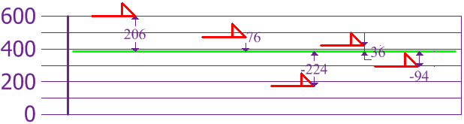
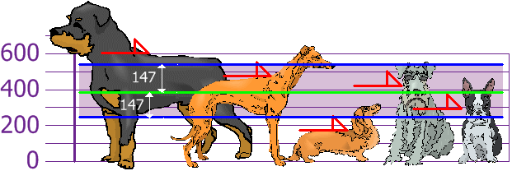
Calculating Variance and SD
So the Variance is 21,704 and Standard Deviation is: 147
So, using the Standard Deviation we have a "standard" way of knowing what is normal, and what is extra large or extra small.

Slide 16
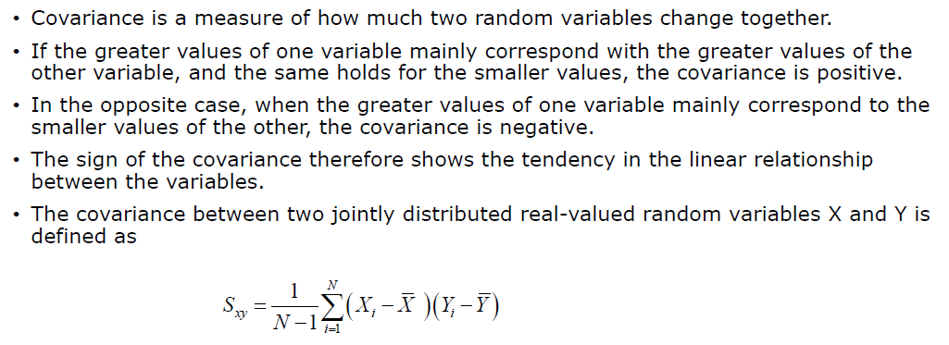
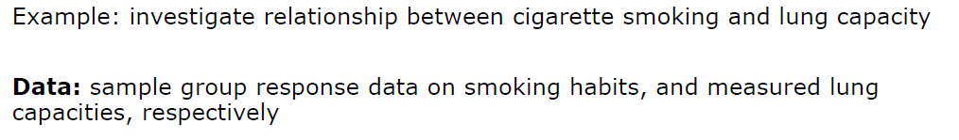
Covariance

Slide 17
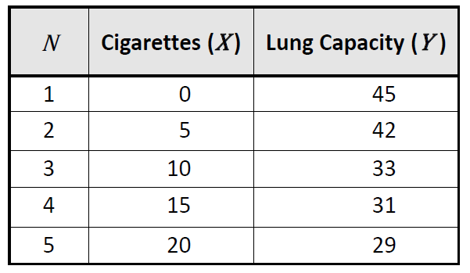
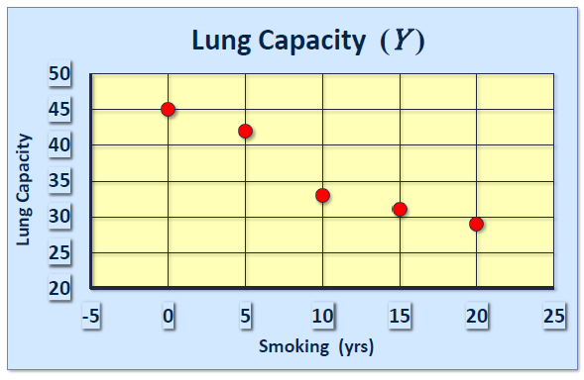
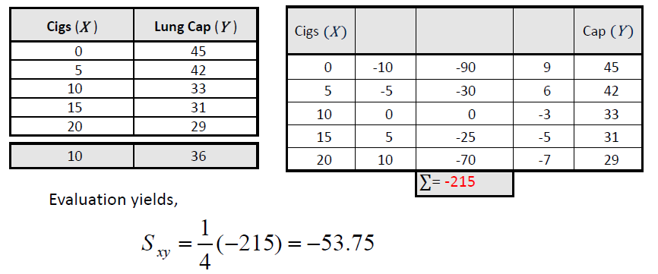
Covariance
X mean=10
Y Mean=36

Slide 18
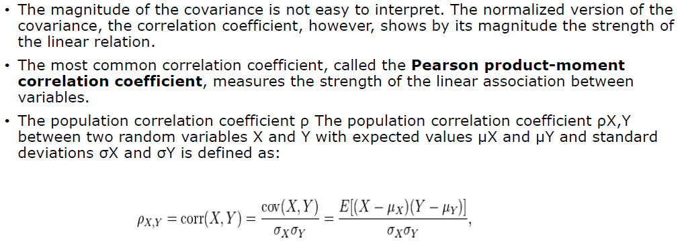
Correlation coefficient

Slide 19
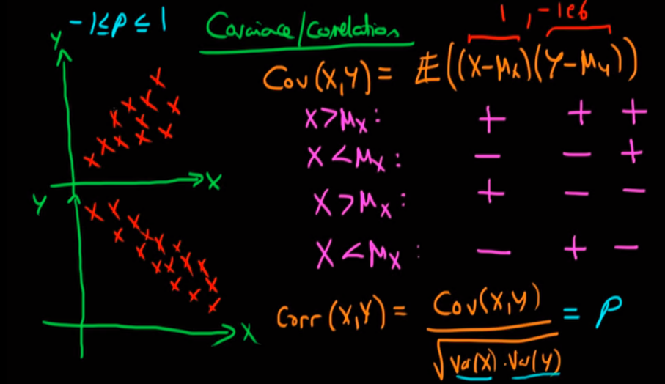
Correlation coefficient

Slide 20
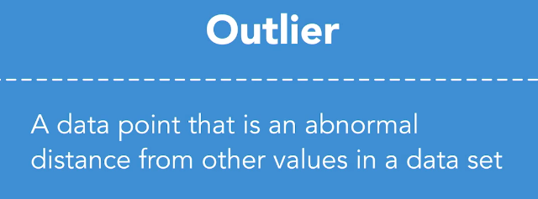
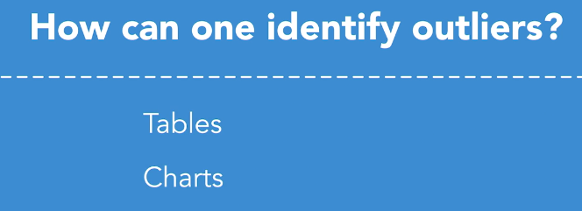
Sometimes they make outliers stand out. Perhaps we use standard deviation. Maybe we say that anything more than two standard deviations from the mean is a statistical outlier.

Slide 21

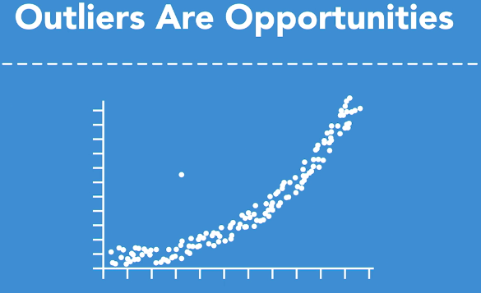

Should we just throw them out, not consider them at all? In general, I'd say no. Most consider outliers as freaks or freakish events that are not likely to be seen again, as a result they're ignored, not considered worth investigating since they're so odd.
Instead though, they should be considered as opportunities. Are they the beginning of a new trend? Does this person know something that we don't? Is it possible others will learn from this outlier.

Slide 22
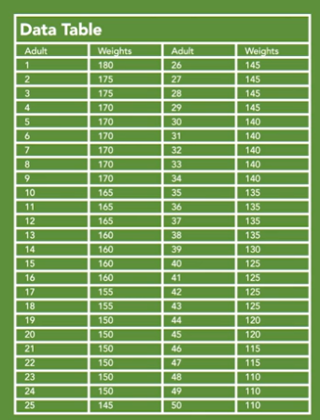
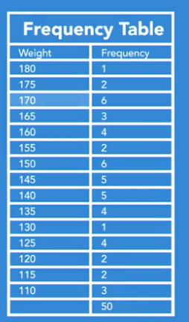
Charts

Slide 23
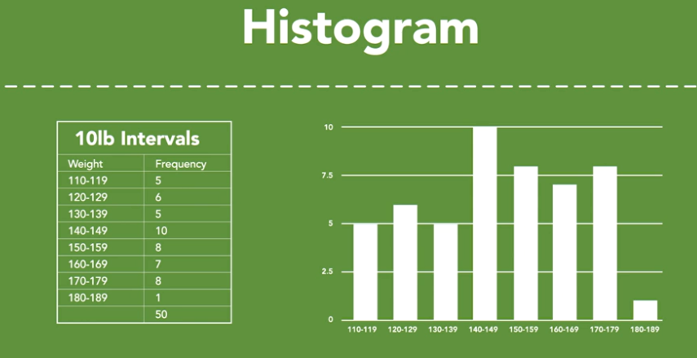

Slide 24
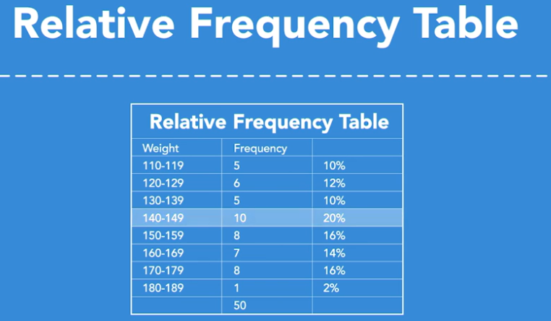

Slide 25
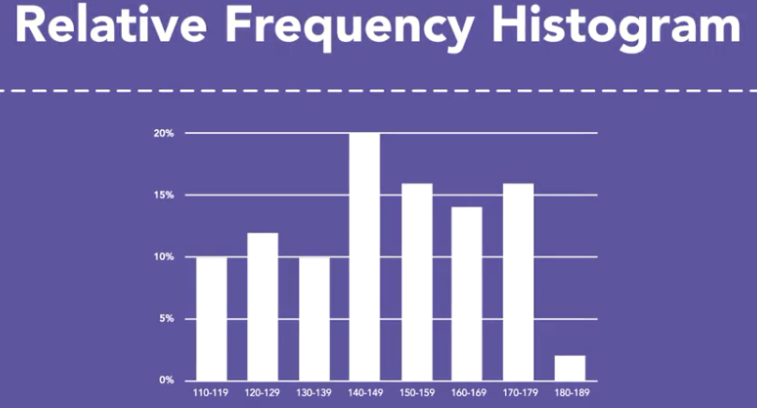

Slide 26
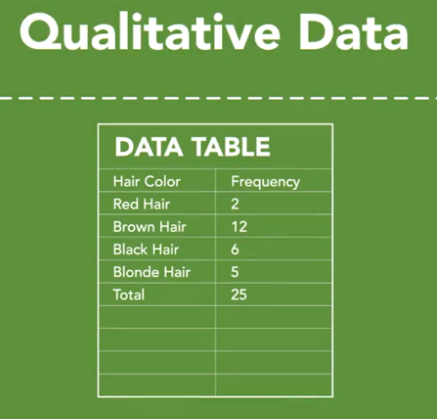
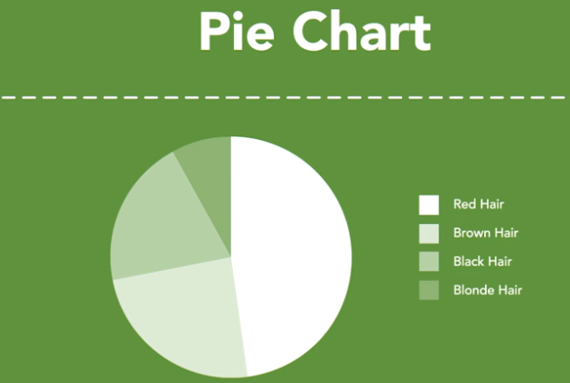

Slide 27
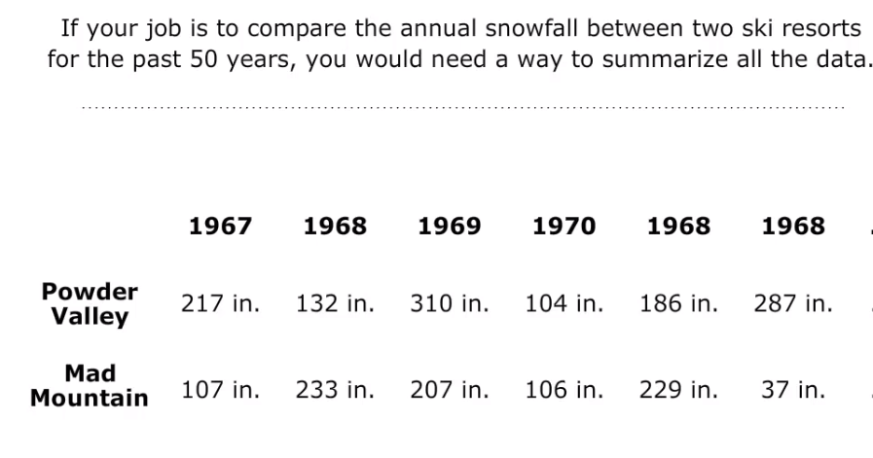
Box Plot

Slide 28
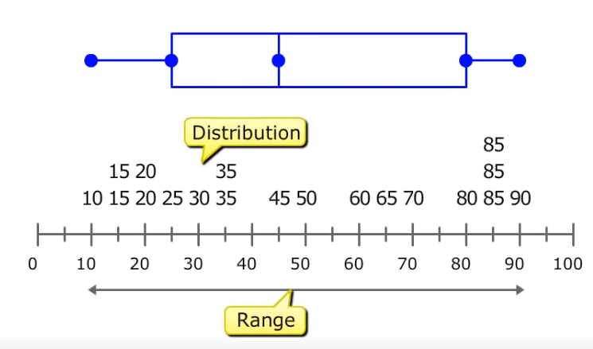
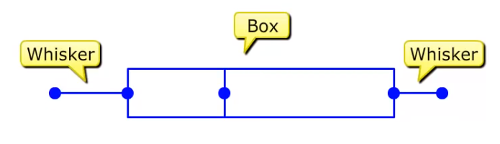
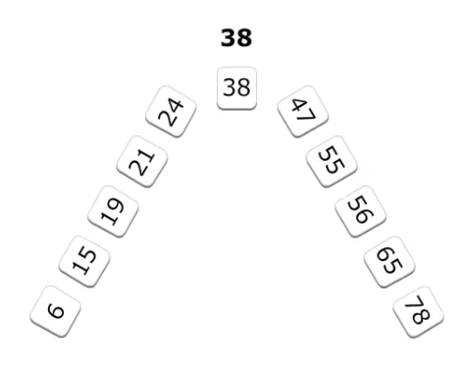
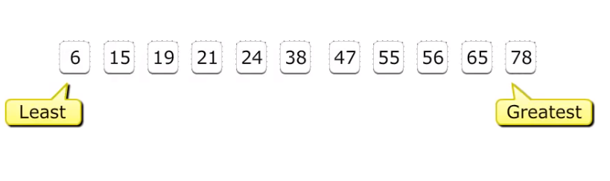

Slide 29
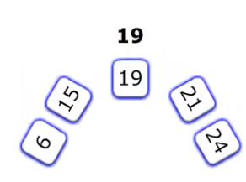
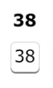
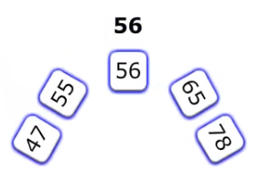
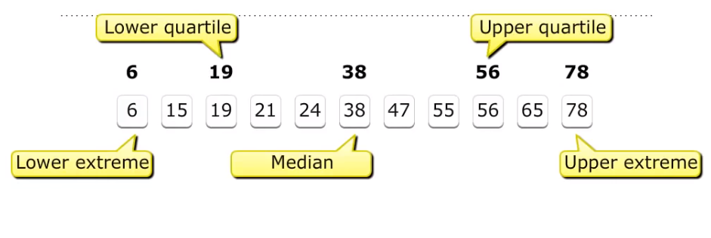

Slide 30
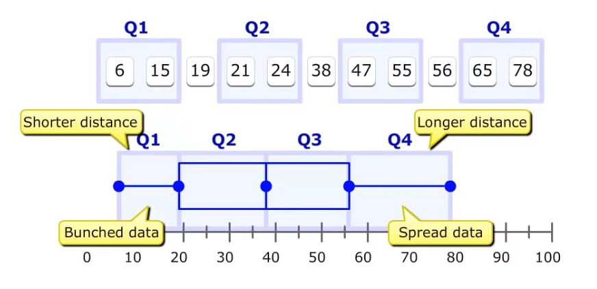

Slide 31


Slide 32
Normal Distribution
A function that represents the distribution of random variable as a symmetrical bell-shaped graph is a normal distribution, normal distribution has below key properties
The mean, mode and median are all equal
The curve is symmetric at the center (i.e. around the mean, μ).
The total area under the curve is 1 (or 100%)
Many groups (psychological, educational variables) follow this type of pattern. That’s why it’s widely used in business, statistics and by government bodies
It is a function of mean and standard deviation of the variable
X ~ N (µ,σ²)

Slide 33


Normal Distribution
When we have mean=0 and standard deviation as 1, then normal distribution is termed as standard normal distribution.
X ~ N (µ,σ²) → Z ~ N(0,1)
SD(mean)=SD/N(No of test)
• 68% of the data falls within one standard deviation of the mean • 95% of the data falls within two standard deviations of the mean • 99.7% of the data falls within three standard deviations of the mean

Slide 34

Why Inferential Statistics
Suppose, you want to know the average salary of Data Science professionals in India. Which of the following methods can be used to calculate it?
Meet every Data Science professional in India. Note down their salaries and then calculate the total average?
Or hand pick a number of professionals in a city like Gurgaon. Note down their salaries and use it to calculate the Indian average.
Well, the first method is not impossible but it would require an enormous amount of resources and time. But today, companies want to make decisions swiftly and in a cost-effective way, so the first method doesn’t stand a chance.
On the other hand, second method seems feasible. But, there is a caveat. What if the population of Gurgaon is not reflective of the entire population of India? There are then good chances of you making a very wrong estimate of the salary of Indian Data Science professionals.
Now, what method can be used to estimate the average salary of all data scientists across India?

Slide 35
In simple language, Inferential Statistics is used to draw inferences beyond the immediate data available.
With the help of inferential statistics, we can answer the following questions:
Making inferences about the population from the sample.
Concluding whether a sample is significantly different from the population. For example, let’s say you collected the salary details of Data Science professionals in Bangalore. And you observed that the average salary of Bangalore’s data scientists is more than the average salary across India. Now, we can conclude if the difference is statistically significant.
If adding or removing a feature from a model will really help to improve the model.
If one model is significantly better than the other?
Hypothesis testing in general.

Slide 36
Terms
Statistic – A Single measure of some attribute of a sample.
For eg: Mean/Median/Mode of a sample of Data Scientists in Bangalore.
Population Statistic – The statistic of the entire population in context.
For eg: Population mean for the salary of the entire population of Data Scientists across India.
Sample Statistic – The statistic of a group taken from a population. For eg: Mean of salaries of all Data Scientists in Bangalore.
Standard Deviation – It is the amount of variation in the population data. It is given by σ.
Standard Error – It is the amount of variation in the sample data. It is related to Standard Deviation as σ/√n, where, n is the sample size.

Slide 37


Bell-shaped curve

Slide 38



In particular, the standard deviation allows us to see whether or not individual data points might be considered outliers.
Is your data point within one standard deviation of the mean, two standard deviations?
How would I know if it is exactly 2.37 standard deviations from the median?

Slide 39

Skewness
Skewness is the measure of asymmetry of the distribution.
Negatively skewed indicates a long left tail.
Positively skewed indicates a long right tail.
No skew indicates a symmetry around the mean.
Coefficient of skewness SK=(mean-median)/SD, if -ve then Negative Skewed, if +ve then Positive skewed and if zero then Normal (no Skew)
skewed towards the left
skewed towards the right

Slide 40


Kurtosis
Kurtosis is the measure of flatness or peakedness of the probability distribution.
It calculates how the Values are bundled across the centre of the distribution.
The normal curve is called Mesokurtic curve.
If the curve of a distribution is more peaked compare to a normal or mesokurtic curve then it is referred to as a Leptokurtic curve.
If a curve is less peaked than a normal curve, it is called as a Platykurtic curve.

Slide 41





Sampling Distribution
when, where and how these samples are collected

Slide 42


Sampling Distribution
Suppose, you note down the salary of any 100 random Data Science professionals in Gurgaon, calculate the mean and repeat the procedure for say like 200 times (arbitrarily).
When you plot a frequency graph of these 200 means, you are likely to get a curve similar to the one below.
A Sampling Distribution behaves much like a normal curve and has some interesting properties like :
The shape of the Sampling Distribution does not reveal anything about the shape of the population. For example, for the above Sampling Distribution, the population distribution may look like the below graph.
Population Distribution
Sampling Distribution helps to estimate the population statistic
.
But how ?
This will be explained using a very important theorem in statistics –The Central Limit Theorem.

Slide 43
Central Limit Theorem
It states that when plotting a sampling distribution of means, the mean of sample means will be equal to the population mean. And the sampling distribution will approach a normal distribution with variance equal to σ/√n where σ is the standard deviation of population and n is the sample size.
Points to note:
Central Limit Theorem holds true irrespective of the type of distribution of the population.
Now, we have a way to estimate the population mean by just making repeated observations of samples of a fixed size.
Greater the sample size, lower the standard error and greater the accuracy in determining the population mean from the sample mean.
This seemed too technical isn’t it? Let’s break this down to understand this point by point.

Slide 44

Central Limit Theorem
This means – No matter the shape of the population distribution, be it bi-modal, right skewed etc. The shape of the Sampling Distribution will remain the same (remember the normal curve- bell shaped). This gives us a mathematical advantage to estimate the population statistic – no matter the shape of the population.
The number of samples have to be sufficient (generally more than 50) to satisfactorily achieve a normal curve distribution. Also, care has to be taken to keep the sample size fixed since any change in sample size will change the shape of the sampling distribution and it will no longer be bell shaped.
As we increase the sample size, the sampling distribution squeezes from both sides giving us a better estimate of the population statistic since it lies somewhere in the middle of the sampling distribution (generally). The below image will help you visualize the effect of sample size on the shape of distribution.
Now, since we have collected the samples and plotted their means, it is important to know where the population mean lies with respect to a particular sample mean and how confident can we be about it. This brings us to our next topic – Confidence Interval.

Slide 45




Confidence Interval
The confidence interval is a type of interval estimate from the sampling distribution which gives a range of values in which the population statistic may lie. Let us understand this with the help of an example.
We know that 95% of the values lie within 2 (1.96 to be more accurate) standard deviation of a normal distribution curve. So, for the above curve, the blue shaded portion represents the confidence interval for a sample mean of 0.
whereas, = the sample mean
= Z value for desired confidence level α
σ = the population standard deviation
Formally, Confidence Interval is defined as,

Slide 46

Example

Slide 47

We find 0.975. This means 97.5% of the data points are to the left of this point and thus, 2.5% of the data points would fall to the right of this point.
As you can see, our z-score is 1.96. This means if we go 1.96 standard deviations in the positive direction and 1.96 standard deviations in the negative direction, 95% of the area under our distribution will fall between these two limits.

Slide 48

Margin of Error.
It is given as {(z.σ)/√n} and defined as the sampling error by the surveyor or the person who collected the samples. That means, if a sample mean lies in the margin of error range then, it might be possible that its actual value is equal to the population mean and the difference is occurring by chance. Anything outside margin of error is considered statistically significant.
And it is easy to infer that the error can be both positive and negative side. The whole margin of error on both sides of the sample statistic constitutes the Confidence Interval. Numerically, C.I is twice of Margin of Error.
The below image will help you better visualize Margin of Error and Confidence Interval.

Slide 49
Practical example
Calculate the 95% confidence interval for a sample mean of 40 and sample standard deviation of 40 with sample size equal to 100.
Solution:
We know, z-value for 95% C.I is 1.96. Hence, Confidence Interval (C.I) is calculated as:
C.I= [{x(bar) – (z*s/√n)},{x(bar) – (z*s/√n)}]
C.I = [{40-(1.96*40/10},{ 40+(1.96*40/10)}]
C.I = [32.16, 47.84]

Slide 50
sampling sampling
Sampling
Probability sampling(Random Sampling) : Each sample(value) from the population of interest has a equal chance of selection.
Simple Random Sampling:- Each group of size N has equal chance of being selected.
Convenience/Biased Sampling:- Use the sample that are easy to get.
Systematic Sampling:- Put a population in some order and select every nth member.
Stratified Sampling:- Break population into Subgroup based on a Characteristics then sample each subgroup.
Cluster Sampling:- Divide Pop. Into Cluster(regardless of characteristics(random cluster) then Randomly select cluster and collect data from entire cluster.
Sampling with replacement : A member of the population may be chosen more than once. Example-Picking a fruit from basket of fruits and placing it back
Sampling without replacement : A member of the population may be chosen only once. Example :Movie ticket

Slide 51

Type of Machine Learning

Slide 52

Type of Machine Learning

Slide 53





Machine Learning Steps

Slide 54






Slide 55






Slide 56


Slide 57


Slide 58

Why Hypothesis testing

Slide 59


Slide 60


Slide 61
Hypothesis testing
Hypothesis testing is a statistical way of evaluation of claim/current assumption about characteristic of data.
Null Hypothesis (H0) : Established fact / Current assumption about data; this is what is always tested for validity
** Takes signs : ‘=’, ‘>=’,’<=’
Examples:
Life of an electric fan is greater than or equal to 3000hrs
Average diameter of balls manufactured in bearing company is 10mm
Average marks obtained by engineering students are less than or equal to 60%
Alternate Hypothesis (H1) : Research hypothesis, challenge to the null hypothesis
** Takes signs : ‘<>’(not equal to), ‘>’,’<’
Types of hypothesis tests based on hypothesis definition:
If H1 has sign ‘<’ : Lower tailed test
If H1 has sign ‘>’ : Upper tailed test
If H1 has sign ‘<>’: Two tailed test

Slide 62



Choosing Test Static
z - value: Used when population standard deviation is known and sample size is greater than 30, data is normally distributed.
t - value: Used when population standard deviation is not known and sample size is less than 30. Used for Comparing the means of two populations.
z = (x bar – mu0) / (sigma / sqrt(n))
T-score (single population)
T-score (two populations)

Slide 63





Slide 64

Statistical significance levels
LoC ( C ) | LoS (Alpha) | Critical value one tailed (Alpha/2) | LoS (Alpha/2) | Critical value Two tailed
0.9 | 0.1 | +/-1.28 | 0.05 | +/-1.645
0.95 | 0.05 | +/-1.645 | 0.025 | +/-1.96
0.98 | 0.02 | +/-2.05 | 0.01 | +/-2.33
0.99 | 0.01 | +/-2.33 | 0.005 | +/-2.575
LoS = 1-LoC
Level of confidence (LoC) : How sure/certain are you about the results. Typical values 99%, 95%, 90%.
Helps in identification of critical values/range of values in hypothesis testing
It means that ‘we can be LoC% sure that range of values contain true mean of the population’.
Level of Significance (LoS): Error that we are ready to accept while performing a hypothesis test.

Slide 65

Hypothesis Testing – Example

Slide 66

Hypothesis Testing – Example, contd

Slide 67
Calculating a Standardized Test Statistic: Sample Problem
The mean life of a particular battery is 75 hours. A sample of 9 light bulbs is chosen and found to have a standard deviation of 10 hours and a mean of 80 hours. Find the standardized test statistic.
The population standard deviation isn’t known, so I’m going to use the t-score formula.
Step 1: Plug the information into the formula and solve:
x̄ = sample mean = 80 μ0 = population mean = 75 s = sample standard deviation = 10 n = sample size = 9
t = 80-75 / (10/√9) = 1.5.
This means that the standardized test statistic (in this case, the t-score) is 1.5. Critical value for 0.5 statistic level is 1.64. t static value 1.5 is less than the critical value.
It means we are failed to accept the null hypothesis. Claim is true.

Slide 68


Linear Regression

Slide 69



Linear Regression
Slop
Intercept of Y

Slide 70

Linear Regression

Slide 71

Linear Regression
Y = β₁ + β₂X + ϵ
where, β₁ is the intercept and β₂ is the slope. Collectively, they are called regression coefficients. ϵ is the error term, the part of Y the regression model is unable to explain.

Slide 72

Residuals
Difference between the observed value of the dependent variable (y) and the predicted value (ŷ) is called the residual (e).

Slide 73


Slide 74


Slide 75


Slide 76


Slide 77

AIC and BIC

Slide 78

Degree of Freedom

Slide 79

Degree of Freedom

Slide 80

Model Quality Check

Slide 81



Slide 82


Slide 83

Probability Calculation for Logistic regression

Slide 84


Slide 85


Slide 86


Slide 87


Slide 88

If you want to represent RANK 1 then rank 2,3&4 become 0.
If you want to represent RANK 2 then rank 3,4 become 0.
If you want to represent RANK 3 then rank 2,4 become 0.
If you want to represent RANK 4 then rank 2,3 become 0.

Slide 89

Assignment

Slide 90

For the 200 total births for this one year, 22.5% of the births occurred in winter versus the expected percentage, 15%. We can also see the data for the other seasons. Does this look like the hospital administrator's report was inaccurate? Before you make a judgement, we need to remember this data is for only a single year. But, suppose we wanted to know if the observed frequencies for this one year provided sufficient evidence to support the seasonal birthrates quoted by the hospital administrator?

Slide 91

Our data is divided into categories. The categories are the seasons. Chi-squared, or the Goodness of Fit Test, is more appropriate for evaluating data sets in which data is categorized.
With a t-test you're evaluating the null hypothesis when two sets of data are collected but not categorized.

Slide 92


Slide 93

Notice this is not an X. It's the Greek letter chi.

Slide 94




Slide 95

Our calculated chi-square value was 9.06. This means we are to the right to 7.815, so we reject our null hypothesis.
The goodness of fit test helped us see that based on our single year of birth data, we can say with 95% confidence that the hospital administrator's stated seasonal distribution was extremely unlikely.

Slide 96

Analysis of Variance, often referred to as ANOVA.
ANOVA is a procedure used to determine if the variation between reported output is the result of some particular factor, or if the variation is simply the result of randomness.
In this case, we have one factor: age. We also consider the number of levels. In this case, we had three levels, since guests were divided into three age ranges.
Hotel Rating by Guests

Slide 97

It looks like ComMobile is providing better service than its competitors.
And it looks like Air Mobile is providing the worst service. I'm simply basing this off of their mean values.
The question is, is it possible that these data values happen by chance and that perhaps the services are equal? In other words, perhaps if the entire population of mobile service users got to try all four companies we would find that there really is not a difference between these companies.

Slide 98

the average of all 16 data values is 5.0.

Slide 99

SST
ANOVA has allowed us to calculate the level of variance between all 16 points in our complete data set and the grand mean of the entire set.

Slide 100

SSW
Instead of subtracting our grand mean, we will be subtracting the individual means for each company.

Slide 101

SSB
The variance between the mean score for each company and the grand mean.
Each company's mean was made up of four data values. So, we need to multiply it by four so each square is representative of each data value.

Slide 102

Anova
Analysis of variance (ANOVA) is a method for testing the hypothesis about the difference between two or more population means
ANOVA compares the amount of variation between the groups with the amount of variation within the groups.
There are several varieties of ANOVA, such as one-factor (or one-way) ANOVA, two-factor (or two-way) ANOVA, and so on, and also repeated measures ANOVA

Slide 103



M is no of levels=4
n(t) is no of records =16

Slide 104

Well, our F-statistic was 0.727, so we definitely do not reject our null hypothesis.
This means that there is not enough evidence to support that there is a significant level of difference between these four mobile service providers. It's likely that the reported difference in their mean scores occurred by chance.

Slide 105

Decision Trees
www.ethans.co.in

Slide 106
What is Decision Tree?
A structure that can be used to divide up a large collection of records into successively smaller sets of records by applying a sequence of simple decision rules.
A decision tree model consists of a set of rules for dividing a large heterogeneous population into smaller, more homogeneous groups with respect to a particular target variable.
Decision tree builds classification or regression models in the form of a tree structure. It breaks down a dataset into smaller and smaller subsets while at the same time an associated decision tree is incrementally developed. The final result is a tree with decision nodes and leaf nodes.

Slide 107
Type Decision tree?
There are many specific decision-tree algorithms. Notable ones include:
CART (Classification And Regression Tree)- IT use Gini index.
Example :- Ctree , rpart
CHAID (CHi-squared Automatic Interaction Detector) - Performs multi-level splits when computing classification trees.
ID3 (Iterative Dichotomiser 3)
ID3 algorithm uses entropy to calculate the homogeneity of a sample.
If the sample is completely homogeneous the entropy is zero and if the sample is an equally divided it has entropy of one
We aim to decrease the entropy of the dataset until we reach leaf nodes at which point the subset that we are left with is pure, or has zero entropy and represents instances all of one class.
Example : C5.0

Slide 108

Why Decision Tree?

Slide 109

Entropy is the measurement how randomly particles can be arranged internally of a object.

Slide 110



Slide 111


Slide 112


Slide 113


Slide 114


Slide 115

Entropy Calculation

Slide 116

Information Gain Calculation

Slide 117


Slide 118


Slide 119



Slide 120


Slide 121


Slide 122


Slide 123


Slide 124


Slide 125


Slide 126


Slide 127


